Slide 1



Chhatrapati Shivaji Maharaj University
Department of Computer Science & Information Technology
BACHELOR OF COMPUTER APPLICATION
Academic Year
2024-25
PROJECT TITLE:
NAVIRIDE (BUS TRACKING APPLICATION)
Presented By
AJIT TORANE ADARSH DUBEY
DILIP RAJBHAR HARSH SHUKLA
KALPESH GHANWAT
UNDER THE GUIDANCE
MR. PUSHKAR JANE

Slide 2


TABLE CONTENT
01
02
03
04
05
06
07
Introduction
Problem Definition
Aims & Objective
Proposed Work
Plan of Work
Conclusion
References

Slide 3
Introduction
  The NaviRide (Bus Tracking Application) project aims to revolutionize public transportation in Navi Mumbai by leveraging modern technology to create a seamless and efficient bus management system.
  This project focuses on the development of both Admin and Customer panels, providing real-time tracking, ticketing, and management solutions for the local bus system.
  The application uses GPS, WebSocket, and Flutter technology to provide up-to-date information to passengers and enhance operational efficiency for administrators.
  . The introduction of a QR code-based ticketing system and a community feature for incident reporting and customer support ensures a better experience for all users.

Slide 4




Problem & Definition
Urban bus transportation in Navi Mumbai suffers from several inefficiencies, negatively impacting both commuters and transport authorities. The key problems faced are as follows:
Lack of Real-Time Bus Tracking
Commuters are unable to track buses in real time, leading to uncertainty about bus arrival times and delays, resulting in longer wait times and inconvenience.
Manual Route and Driver Management
Admins manually assign and track routes for drivers and conductors, making the process of route allocation and scheduling inefficient, leading to potential errors and delays.
Inefficient Ticketing Process
The traditional manual ticketing system slows down the boarding process, creates discrepancies, and leads to potential revenue loss due to errors in ticket validation.

Slide 5
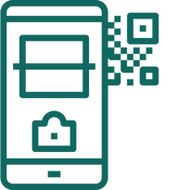
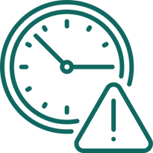

Problem & Definition
The NaviRide (Bus Tracking Application) project aims to improve operational efficiency, reduce costs, and enhance the user experience in Navi Mumbai's public transportation by providing real-time tracking, streamlined ticketing, and better communication among stakeholders.
No QR Code-Based Ticket Verification
Conductors struggle with manual ticket checks, making it difficult to verify the authenticity of tickets, which slows down the boarding process and increases the risk of fraud.
Delayed Monthly Pass Approval
The manual process of verifying and approving monthly passes increases the workload for administrators and delays service for commuters who rely on these passes for their daily travel.
Inability to Easily Access Bus Schedules and Show Tickets
Customers struggle to effectively plan journeys due to the absence of a user-friendly platform for checking bus schedules and displaying previously booked tickets.

Slide 6




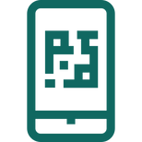

Aims & Objective
The NaviRide (Bus Tracking Application) project is designed with the following aims and objectives:
01
02
03
04
Enhance Commuter Experience
Increase Operational Efficiency
Digital Ticketing System
Incident Reporting and Community Interaction
Provide real-time tracking, ticket booking, and easy access to bus schedules.
Simplify driver and route management, and introduce data analytics to optimize routes and schedules.
Eliminate paper tickets and introduce QR code-based ticketing to speed up the boarding process.
Create a platform where passengers can share experiences, report incidents in real-time, and access customer support.

Slide 7

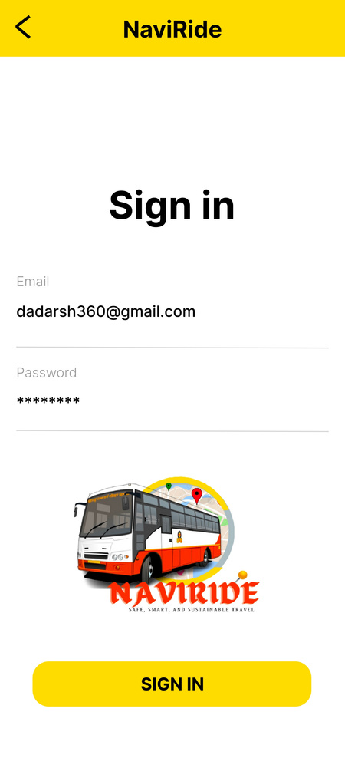
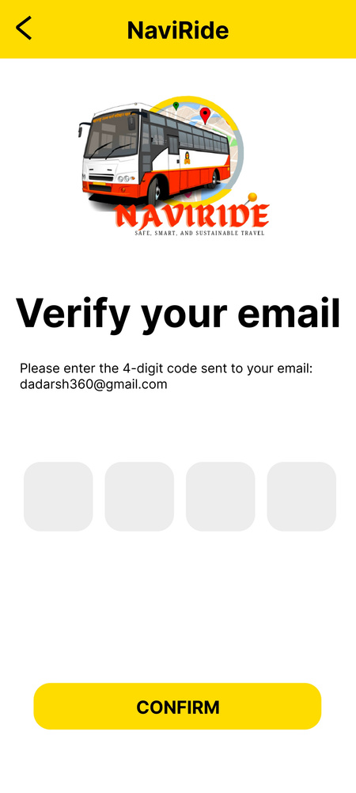
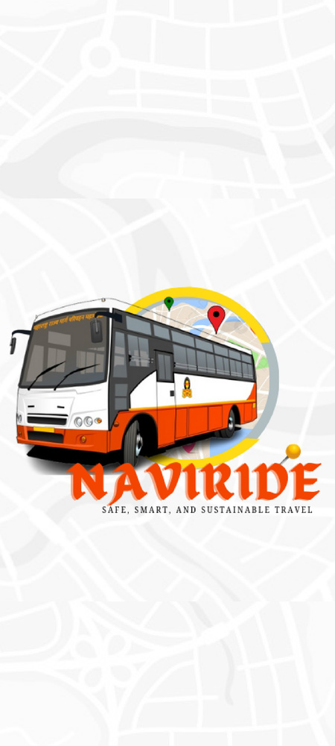
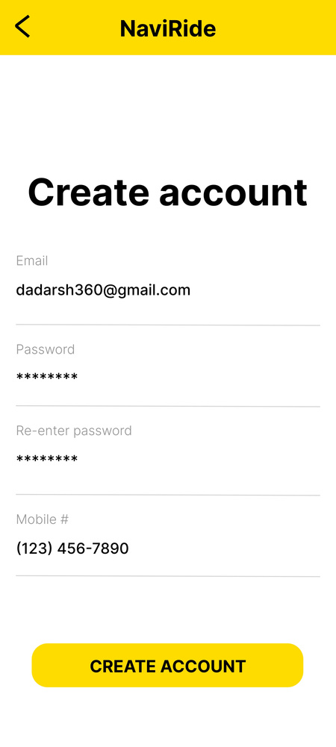
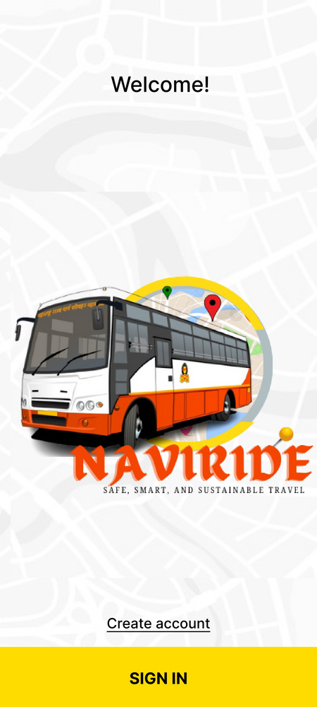
Proposed Work
Verify the User Interface Screen
Login Interface Screen
Welcome Interface Screen
Splash Screen
Create Account Interface Screen

Slide 8
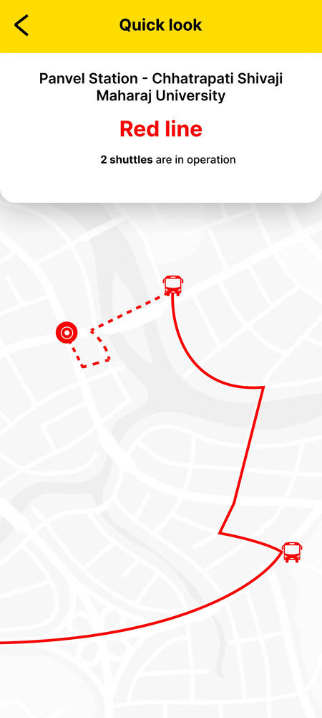
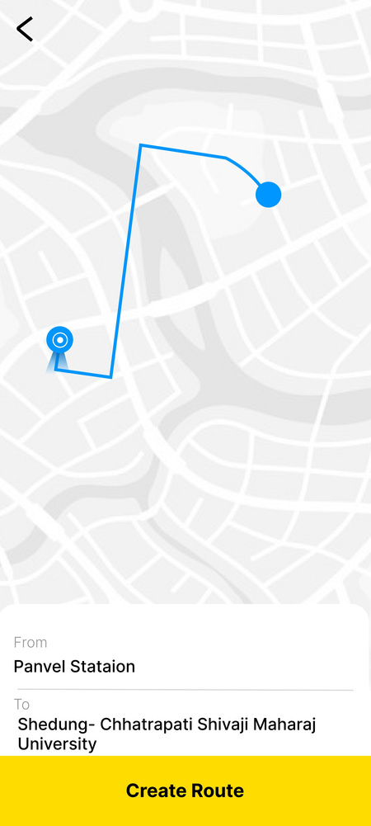
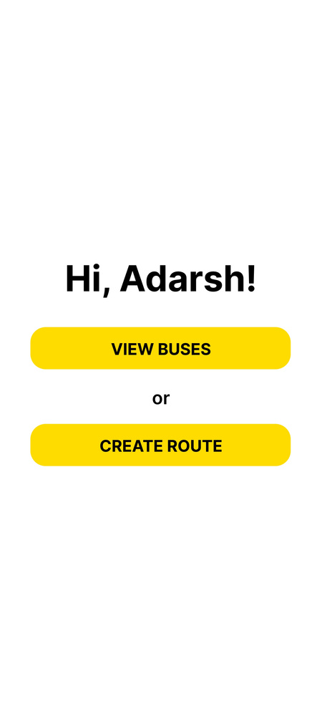
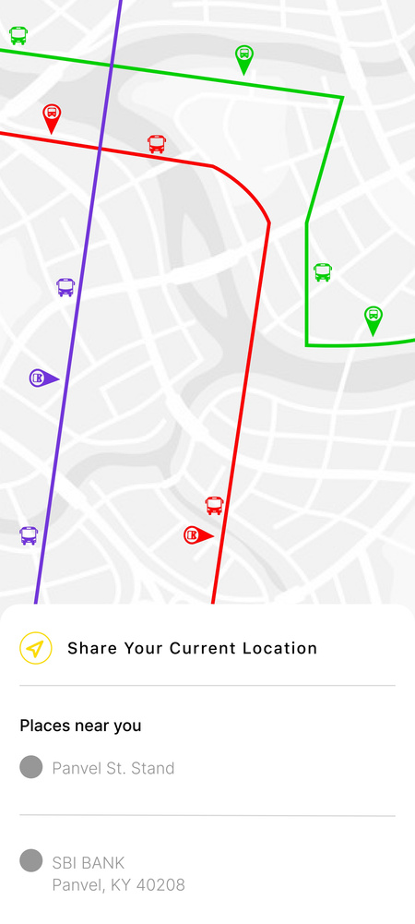
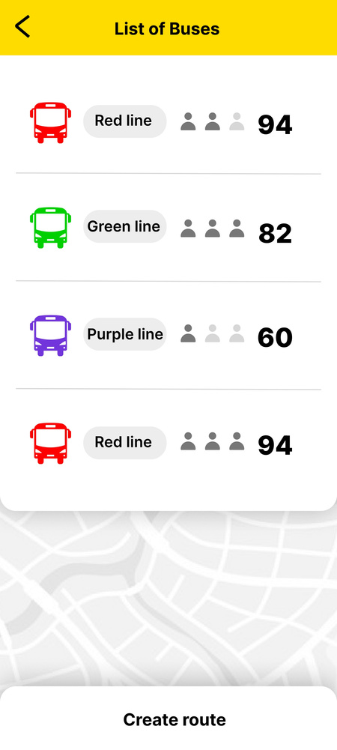
Proposed Work
CREATE ROUTES USER INTERFACE
SELECT ROUTES
INTERFACE
BUSSES LIST INTERFACE
VIEW BUSES INTERFACE
ADD LOCATION INTERFACE

Slide 9
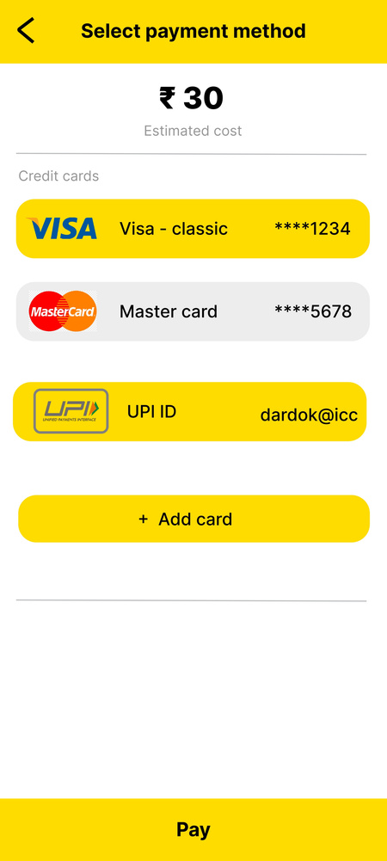
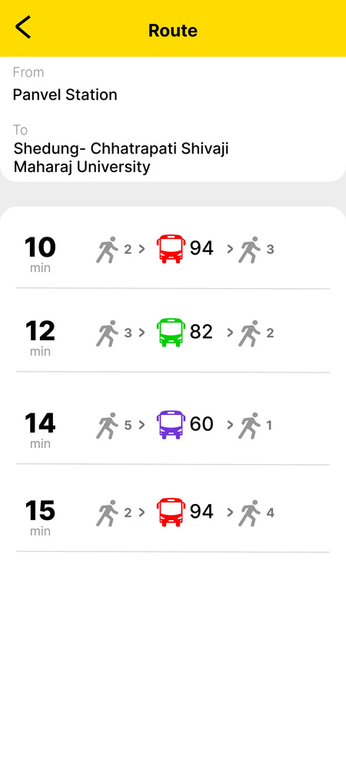
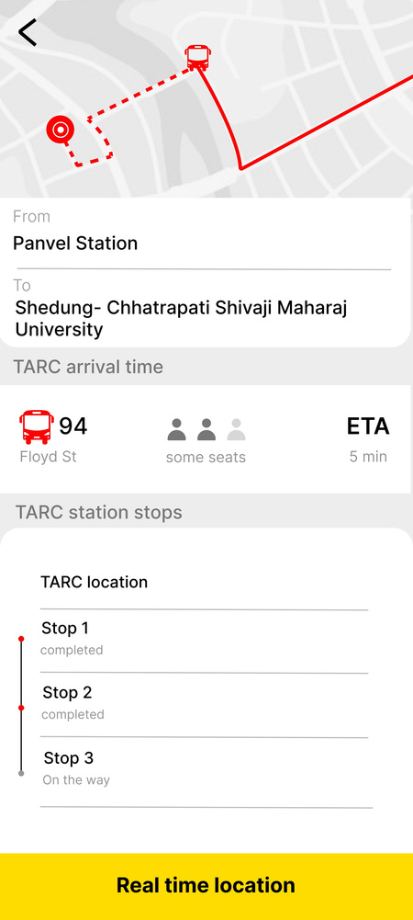
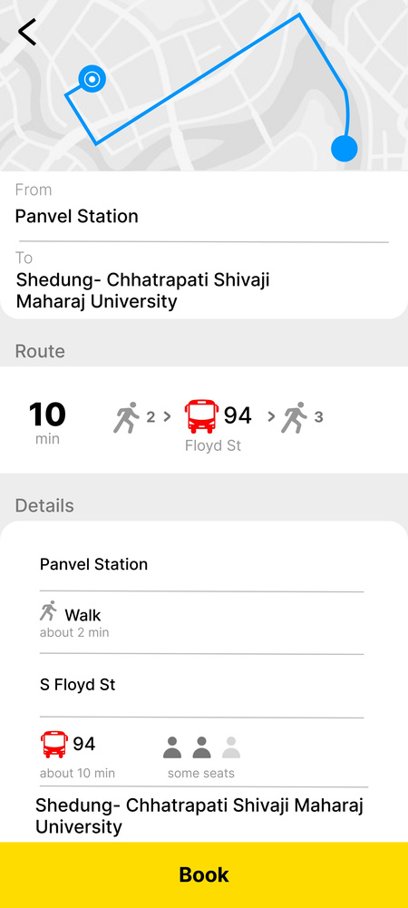
Proposed Work
TRACK BUS USER INTERFACE
PAYMENT
INTERFACE
DETAILS OF CHOSEN ROUTE INTERFACE
LIST OF POSSIBLE ROUTES INTERFACE
TICKET INTERFACE

Slide 10
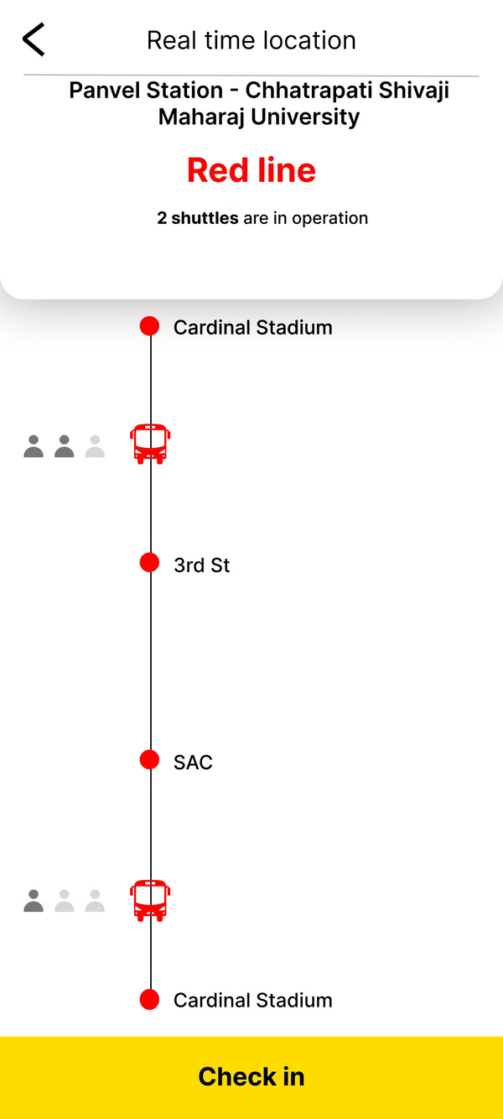
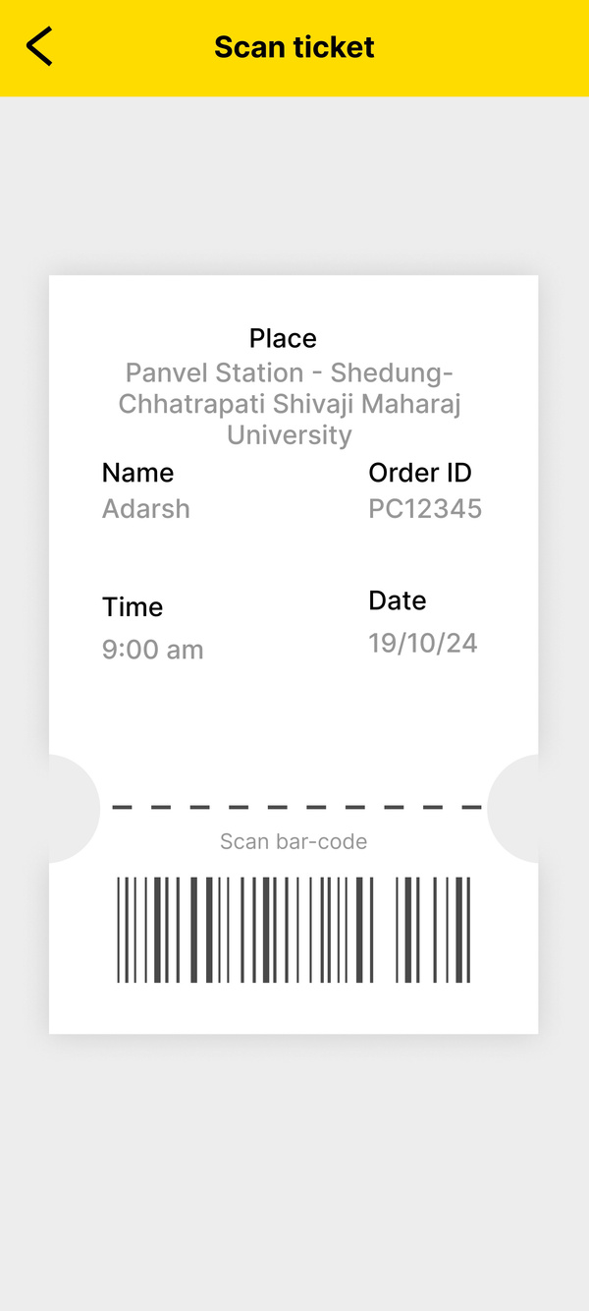
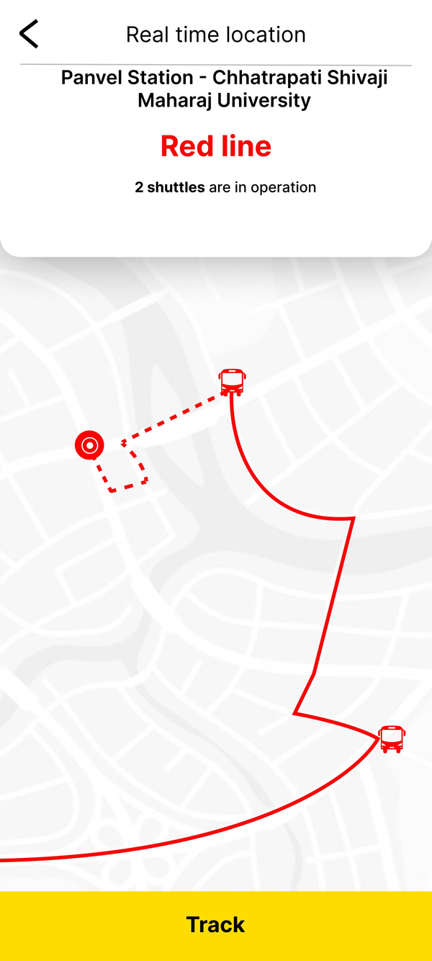
Proposed Work
TICKET SCAN INTERFACE
CURRENT LOCATION - 2 INTERFACE
CURRENT LOCATION INTERFACE

Slide 11
Plan of Work
Requirement Analysis and Research
System Design and Architecture
Development
1)Conduct a survey to understand commuter needs.
2)Analyze existing bus transportation challenges in Navi Mumbai.
1)Create wireframes for both admin and customer panels.
2)Design a modular and scalable database structure using Firebase.
3)Architect the application to support real-time updates via WebSocket and GPS tracking.
1)Admin Panel Development: Create a dashboard for managing bus schedules, routes, and staff.
2)Customer Panel Development: Implement ticket booking, QR code generation, and real-time tracking features.
3)Integrate Google Maps API for live bus tracking visualization.
Integration and Testing
Deployment
Maintenance and Support
1)Integrate GPS data feeds with the backend.
2)Conduct rigorous testing to ensure data accuracy in real-time tracking.
3)Perform user acceptance testing to refine the UI/UX.
1)Deploy the application on cloud services like Firebase or AWS for backend operations.
2)Publish the app on Google Play Store and Apple App Store for public access.
1)Provide regular updates for feature enhancements and security patches.
2)Offer 24/7 customer support through an in-app chatbot or help desk system.

Slide 12
Conclusion
The NaviRide app will enhance the public transportation experience for commuters in Navi Mumbai.
The platform connects passengers and bus authorities through real-time bus tracking, digital ticketing, and community features.
Using Flutter and Dart makes the application responsive and scalable for the city's residents' needs.
Using Flutter and Dart ensures the application is responsive and scalable for residents.

Slide 13
References
Flutter Documentation: Comprehensive guides and examples for Flutter development.
Website: Flutter.dev
Google Maps API: Information on integrating maps and GPS features into mobile applications.
Website: Google Maps Platform
WebSocket Communication: Real-time data streaming techniques using WebSocket in mobile applications.
Documentation: WebSocket Protocol
Firebase Realtime Database: Best practices for managing dynamic data in real-time.
Website: Firebase
Mapbox: Detailed instructions on adding advanced mapping functionalities to your app.
Website: Mapbox
These resources will help guide the development and optimization of the NaviRide (Bus Tracking Application) application.

Slide 14


Thank
You

